Slide 1
NAMES AND FORMULAE OF IONIC COMPOUNDS
Students will be able to write the names and formulas of different ionic compounds
Notes:
Insert cover image and use transparency settings to fade image.

Slide 2
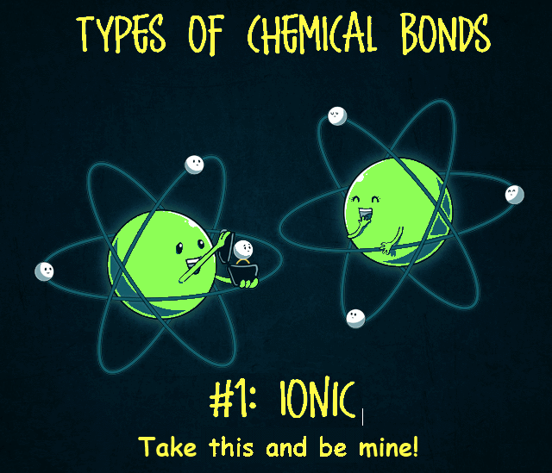
Types of Bonds
Ionic: Metal + Non-Metal
Metallic: Metal + Metal
Covalent: Non-Metal + Non-Metal
How do we name them?
How do we write their formulae?

Slide 3
Students will be able to write the names and formulas of different ionic compounds
TRACK WITH ME
READ WITH ME
Define and explain the terms cation and anion
Write the names of ionic compounds
Write the formulas of ionic compounds
DECLARE THE OBJECTIVE
Read the learning objective to your partner.
Notes:
Learning Objectives contain concepts (nouns, big ideas), skills (verbs, measurable behaviours) and sometimes context (restricting or targeting conditions).
●Example: Students will be able to describe the concept of density and apply it to floating and sinking.
●
Success criteria are specific measurable outcomes that if met mean that the student has met the learning objective.
Examples:
•Students will be able to compare densities of substances using mass and volume.
•Students will be able to identify whether a solid or liquid will float or sink in a liquid based on their densities.

Slide 4

What is an ion?
An atom or group of atoms that carries a positive or negative electric charge as a result of having lost or gained one or more electrons.
Atoms that lose electrons become a positively (+) charged ion because: # of protons > # of electrons. Positive ions are called cations
Atoms that gain electrons become a negatively (-) charged ion because: # of protons < # of electrons. Negative ions are called anions

Slide 5
Ionic bonding E.g. Sodium + Chlorine → Sodium chloride
Na
Cl
Outer shells not full!

Slide 6
Ionic bonding E.g. Sodium + Chlorine → Sodium chloride
NaCl (Na⁺Cl⁻⁾
Na
Cl
Both ions have full outer shells
Notes:
Copy example

Slide 7
CHECK FOR UNDERSTANDING
aluminium chloride
2 elements – aluminium and chlorine
AlCl₃
Cl = chlorine – 3 atoms
Al = aluminium – 1 atom
VOCABULARY

Slide 8
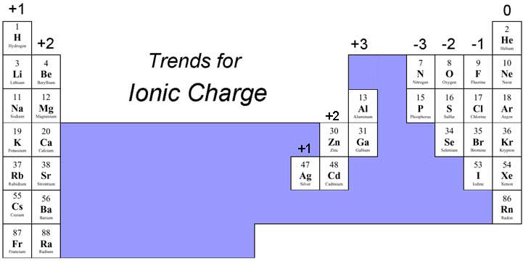
How do I find out the charge on an ion quickly?

Slide 9
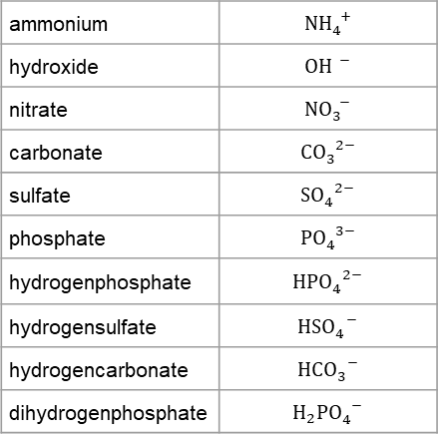
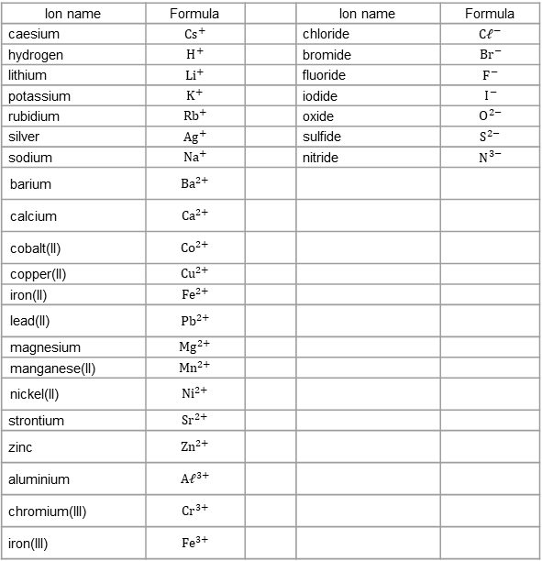
Polyatomic ions (provided to you on data sheet)
Can be figured out using your Periodic Table (not on data sheet)
ammonium | $${NH}_{4}^{ +}$$
hydroxide | $${OH}^{ −}$$
nitrate | $${NO}_{3}^{ −}$$
carbonate | $${CO}_{3}^{ 2−}$$
sulfate | $${SO}_{4}^{ 2−}$$
phosphate | $${PO}_{4}^{ 3−}$$
hydrogenphosphate | $${HPO}_{4}^{ 2−}$$
hydrogensulfate | $${HSO}_{4}^{ −}$$
hydrogencarbonate | $${HCO}_{3}^{ −}$$
dihydrogenphosphate | $$H_{2}{PO}_{4}^{ −}$$
Ion name | Formula |  | Ion name | Formula
caesium | $${Cs}^{+}$$ |  | chloride | $${C𝓁}^{−}$$
hydrogen | $$H^{+}$$ |  | bromide | $${Br}^{−}$$
lithium | $${Li}^{+}$$ |  | fluoride | $$F^{−}$$
potassium | $$K^{+}$$ |  | iodide | $$I^{−}$$
rubidium | $${Rb}^{+}$$ |  | oxide | $$O^{2−}$$
silver | $${Ag}^{+}$$ |  | sulfide | $$S^{2−}$$
sodium | $${Na}^{+}$$ |  | nitride | $$N_{}^{3−}$$
barium | $${Ba}^{2+}$$
calcium | $${Ca}^{2+}$$
cobalt(II) | $${Co}^{2+}$$
copper(II) | $${Cu}^{2+}$$
iron(II) | $${Fe}^{2+}$$
lead(II) | $${Pb}^{2+}$$
magnesium | $${Mg}^{2+}$$
manganese(II) | $${Mn}^{2+}$$
nickel(II) | $${Ni}^{2+}$$
strontium | $${Sr}^{2+}$$
zinc | $${Zn}^{2+}$$
aluminium | $${A𝓁}^{3+}$$
chromium(III) | $${Cr}^{3+}$$
iron(III) | $${Fe}^{3+}$$

Slide 10
Naming ionic compounds is very straightforward. The name is comprised of two words – the first word is the name of the positive ion and the second word is the name of the negative ion.
Some ions tell us their charge, e.g. Cu²⁺ is copper(II), and we do not use prefixes (mono, di, tri, etc) when naming ionic compounds.
Examples:
Why are brackets used here? Find out on Slide 14!
MgCℓ2 | magnesium chloride
Aℓ2O3 | aluminium oxide
Zn(NO3)2 | zinc nitrate
(NH4)2SO4 | ammonium sulfate
Cu(OH)2 | copper(II) hydroxide

Slide 11
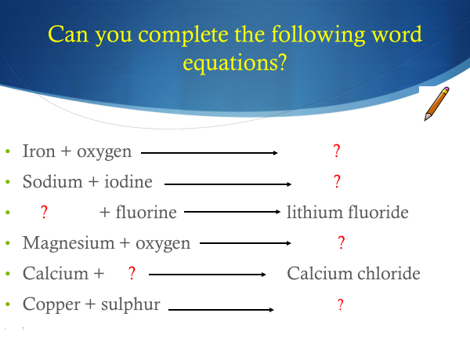
The name of the metal goes first, the non-metal changes the ending to “ide”
sodium + chlorine sodium chloride
copper + oxygen copper oxide

Slide 12
If naming with a polyatomic ion (carbonate, sulphate, etc)
Use the name of the polyatomic ion as the ending
e.g: copper + sulphate = copper sulphate
Copy the following formulae and then write the name of each compound;
1. NaBr 2. FeSO₄
3. KNO₃ 4. FeS
5. AgNO₃ 6. FeO
7. CsF 8. Al₂O₃
9. CoCl₂ 10. H₂O

Slide 13
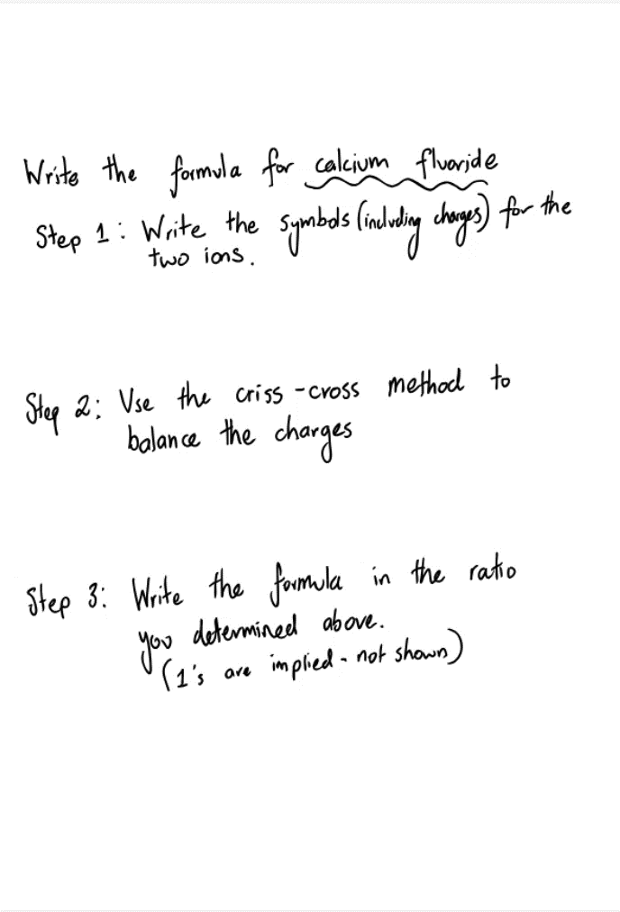
Writing Formula for Ionic Compounds
Even though ionic compounds are made up of particles that have either a positive charge or a negative charge, they are electrically neutral (they have no overall charge). This means that the total positive charge from all the cations is equal to the total negative charge from all of the anions. We apply this idea when writing formula for ionic compounds.
Example:
Write the formula for calcium fluoride.

Slide 14
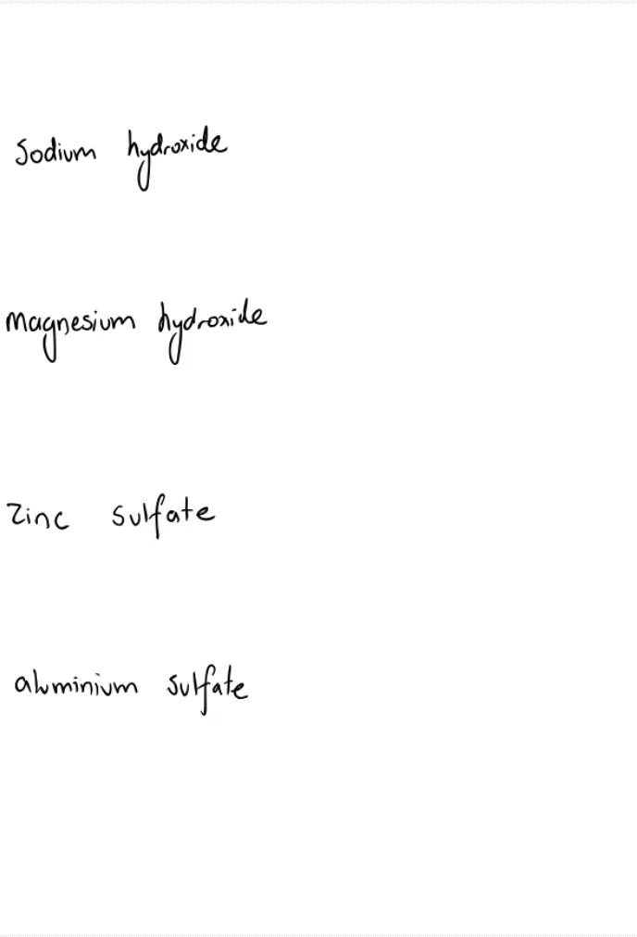
How to write the formulas of ionic compounds containing polyatomic ions
sodium hydroxide
magnesium hydroxide
zinc sulfate
aluminium sulfate

Slide 15
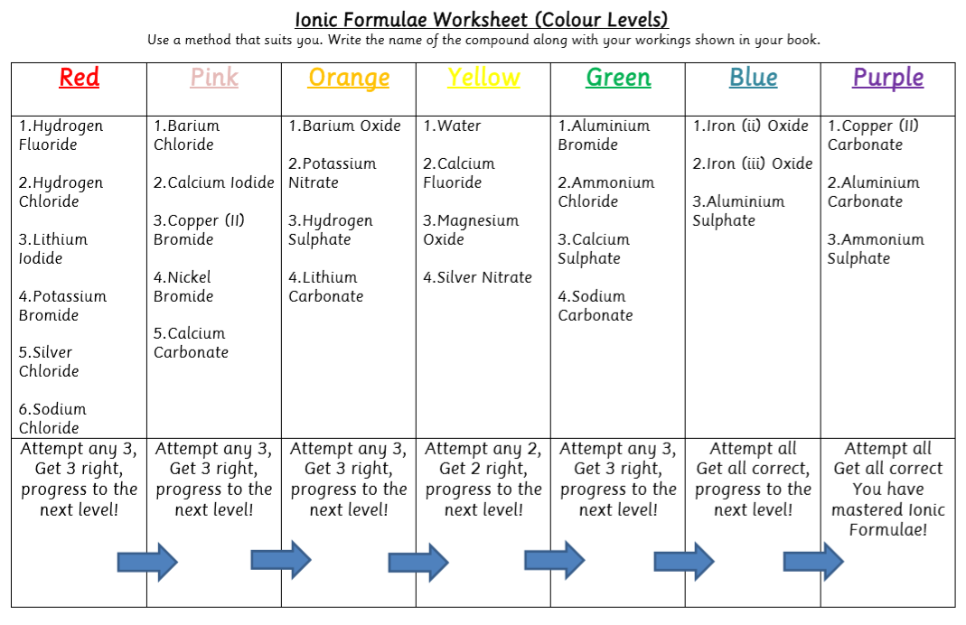
Task: Start at Red. Choose any 3 – if you get them right – move to the next colour and repeat!
HINT
Transition metals have their positive charge in brackets (as they can have multiple charges. E.g. Copper (II) = Copper 2⁺
HINT
Google the name of the compound to check your answers!
Notes:
Please include tasks/questions here rather than just referring to a worksheet. This will save on photocopying and facilitate sharing with other schools.
Try and build tasks/questions which escalate through Bloom’s Taxonomy. This will help with differentiation.

Slide 16
Complete the Google Forms task on Google Classroom.
1. Open the PPT ‘Ionic Bonding Check for Understanding’
2. Type your answers into the Google Form titled ‘Ionic Bonding Check for Understanding’

